Slide 1
Maximizing independence and quality at end of life.
(Caroline Mathias O.T)

Slide 2
‘How people die remains in the memory of those who live on’
(Dame Cicely Saunders – founder of the modern hospice movement)

Slide 3
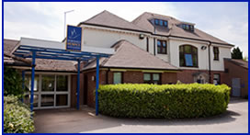
St.Michael’s Hospice
(North Hampshire)

Slide 4
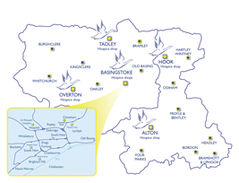
Catchment

Slide 5
Range of services offered at SMH
Inpatient Unit (10 beds)
Hospice at home
Day Services
Out Patient Services including Motor neuron Disease and therapeutic clinic, Lymphoedema and other conditions, MSA, brain tumours
Approx 19% funding for SMH from government, rest is through fundraising.

Slide 6
Rehabilitative Palliative Care: enabling people to live fully until they die – A challenge for the 21st Century
(Report published by St.Joseph’s hospice July 2015)

Slide 7
What is end of life?

Slide 8
General Medical Council definition (NICE guidelines)
when a person is likely to die within the next 12 months. This timeframe provides a guide as to when people might be identified as approaching the end of life. For some conditions, the trajectory may require identification and subsequent planning to happen earlier. For other conditions, it may not be possible to identify people until nearer the time of death. Identification should take place with sufficient time to enable provision of high-quality end of life planning, care and support in accordance with the person's needs and preferences. Identification will need to be considered on an individual basis.

Slide 9
MND clinic at SMH
Started 4 years ago in conjunction with Consultant Neurologist, Palliative Medicine Consultant, MNDA care centre coordinator, Physiotherapist and Occupational Therapist.
35 people with MND have been referred, 16 have died, 3 moved out of the area or discharged.
PT/OT currently undergoing research project with Southampton University to evaluate the therapy input to the clinic.

Slide 10
What do you believe would be important to you at the end of your life?

Slide 11
Case study of person with MND at end of life
MND:a syndrome comprising a range of clinical phenotypes with a common theme of progressive, degenerative ,motor neuronopathy. Nerve messages stop reaching the muscles leading to weakness and wasting of muscles. Cause unknown but 1 in 10 people thought to have a genetic link. No definitive diagnostic test and no known cure for disease, Use of Riluzole has shown slight lengthening in prognosis for small number of people.

Slide 12
Types of MND
There are several but not always discrete or specific and symptoms often overlap:
Amyotrophic Lateral Sclerosis (ALS at least 80% of all cases)
Average life expectancy is 2-5 years
Progressive Bulbar Palsy
Progressive Muscular Atrophy
Primary Lateral Sclerosis
Respiratory Onset and others.

Slide 13
Case study
Ideally what range of services would John/Louise need throughout this year of him living with his disease and at what point would you involve various professionals/services?

Slide 14
Comments on case study
Has this person’s independence and quality been maximised at end of life?

Slide 15
Conclusion
Would it be more accurate to aim to maximise independence and choice at end of life rather than quality?
Communication
Collaboration
Demands on our services are only going to increase
‘If you do what you always did you will get what you always got’
(Albert Einstein)

Slide 16
Questions?

